Slide 1
Automatic Generation of Web Interfaces From User Interaction Diagrams
Filipe Bianchi Damiani
Patrícia Vilain
Federal University of Santa Catarina (UFSC) - Brazil

Slide 2
Overview
1. Introduction
2. User Interaction Diagrams
3. Java Server Faces
4. Mapping Rules
5. Example
6. Conclusions

Slide 3
Overview
1. Introduction
2. User Interaction Diagrams
3. Java Server Faces
4. Mapping Rules
5. Example
6. Conclusions

Slide 4
1. Introduction
The requirements gathering is one of the system development steps.
Modeling the interaction between the user and the system can help to gather functional requirements.
The interaction can be described by
Text (Scenarios, Use Cases, etc)
Diagram (User Interaction Diagrams (UIDs), etc)
Can web user interfaces be generated from an interaction model?

Slide 5
Introduction
The user inputs and outputs of UIDs can be mapped to inputs and outputs of web pages components.
It is defined a set of rules to map functional requirements represented in UIDs to web pages using JSF.
It is developed a tool that automatically implements these rules.

Slide 6
Overview
1. Introduction
2. User Interaction Diagrams
3. Java Server Faces
4. Mapping Rules
5. Example
6. Conclusions

Slide 7
2. User Interaction Diagram (UID)
Diagrammatic notation that represents the exchange of information between a user and a system.
Does not reveal specific user interface aspects.
UID: Selection of a CD based on a given title

Slide 8
Overview
1. Introduction
2. User Interaction Diagrams
3. Java Server Faces
4. Mapping Rules
5. Example
6. Conclusions

Slide 9
3. Java Server Faces (JSF)
Framework for developing web applications using the Java technology.
It follows the design pattern MVC (Model-View-Control), separating the business model and the visualization.
Each JSF visual component has a direct representation in a HTML component.

Slide 10
Java Server Faces
Some JSF components relevant to this work:
form | inputText
panelGrid | outputLink
panelGroup | commandLink
column | commandButton
dataTable | selectManyCheckbox
outputText | selectOneRadio
outputLabel

Slide 11
Overview
1. Introduction
2. User Interaction Diagrams
3. Java Server Faces
4. Mapping Rules
5. Example
6. Conclusions

Slide 12
4. Mapping Rules
Map UID elements directly to JSF components.
They were based on:
Mapping of UIDs elements to abstract widgets
Possible representations of JSF components to the abstract widgets
Relevant information available in UIDs

Slide 13
Mapping Rules
UID Elements | JSF Components
text | outputText
data item (system output) | if the data item is the source of any transition, it is mapped to a commandLink otherwise, it is mapped to an outputText
structure (system output) | if the structure is not the source of any transition and does not contain elements, it is mapped to an outputText if the structure is the source of a transition and does not contain elements, it is mapped to a commandLink if the structure contains elements, it is mapped to a panelGrid with an outputLabel. Each element within the structure is mapped according to its type

Slide 14
Mapping Rules
UID Elements | JSF Components
set of data items (system output), set of structures (system output) | if the set is not the source of any transition, it is mapped to a dataTable otherwise, its mapping is done as in the mapping of a transition
data item (user entry) | inputText
structure (user entry) | panelGrid with an outputLabel. Each element within the structure is mapped according to its type and the resulting JSF components are included into the panelGrid (mapping rules are recursively applied to nested elements) if the structure does not have elements, it is mapped to an inputText with an outputLabel

Slide 15
Mapping Rules
UID Elements | JSF Components
set of data items (user entry) | if the set has an upper limit (0..*), it is mapped to an inputText with an outputLabel otherwise, inputText components must be replicated up to the number of required entries
set of structures (user entry) | if the set has an upper limit and the structure does not contain elements, its mapping is done as in a set of data items if the set has a relatively small upper limit, it is mapped to a dataTable and each element to a column if the set has no upper limit, it is mapped as a single structure
selection between two data items (or) | selectManyCheckbox

Slide 16
Mapping Rules
UID Elements | JSF Components
selection of a data item (xor) | selectOneRadio
enumerated user entry | if only one item can be chosen, it is mapped to a selectOneRadio if more than one item can be chosen, it is mapped to a selectManyCheckbox
interaction state | it is mapped to a form. The JSF components that correspond to the elements of the interaction state are added to the form. Note that a single form component can implement more than one interaction state
sub-state | form

Slide 17
Mapping Rules
UID Elements | JSF Components
transition with the selection of an option | if the source is a structure, it is mapped to a commandLink added to the panelGrid obtained from mapping the structure …
transition with selection of elements | if the source is a set of data items and just one element can be selected, the set is mapped to a dataTable with a column containing commandLinks around the items; …
call of another UID, call from another UID, pre-conditions, post-conditions, parameters and notes | ignored as there are no matching JSF components

Slide 18
Mapping Rules
A prototypical tool that automates the UID-to-JSF mapping rules were developed.
It reads UID information stored in one or more XML documents and generates JSF pages.
It was developed for JSF version 2.0.

Slide 19
Overview
1. Introduction
2. User Interaction Diagrams
3. Java Server Faces
4. Mapping Rules
5. Example
6. Conclusions

Slide 20
5. Example
Set of JSF pages automatically generated by our mapping tool
Use Case: Buying a CD from an Advanced Search
Description:
1. The user enters some keywords, artist’s name, CD title or record label, and chooses ‘CD’ as the media format.
2. The system returns a set of CDs that match the entries. For each CD listed, the following data are given: CD title, artist’s name, year, recommendation, stock price, stock quantity, price of a new one (from a reseller), and price of a used one (from a reseller).
3. The user selects one CD from the set and the system shows the specific information about that CD, including the CD title, artist’s name, recommendation, stock price, stock quantity, price of a new one, price of a used one and artist’s biography.
4. If the user wants to buy that CD or has interest on it, he or she can instantly proceed with the purchase (one-click ordering), add it to the shopping cart to buy it later or instead simply add it to a wishing list.

Slide 21
Example
UID corresponding to the use case.

Slide 22
Example
UID corresponding to the use case.

Slide 23
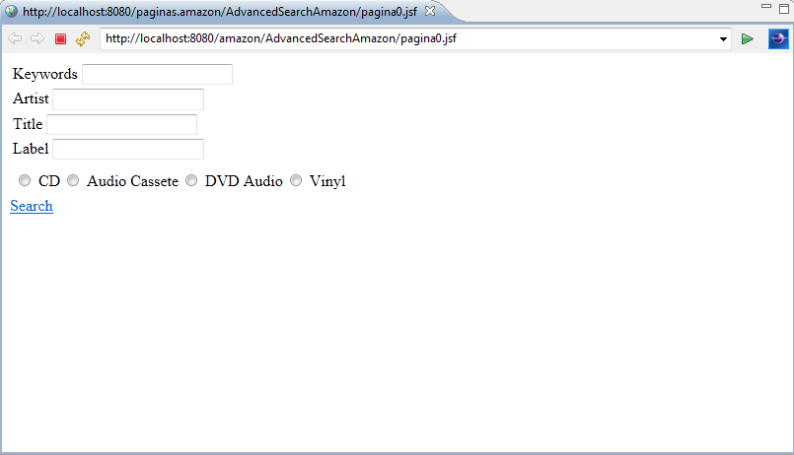
Example
Generated web page corresponding to the initial interaction state
1
transition with option >> commandLink
3
user input >> inputText
enumerated user entry
>> selectOneRadio
2

Slide 24
Example
UID corresponding to the use case.

Slide 25
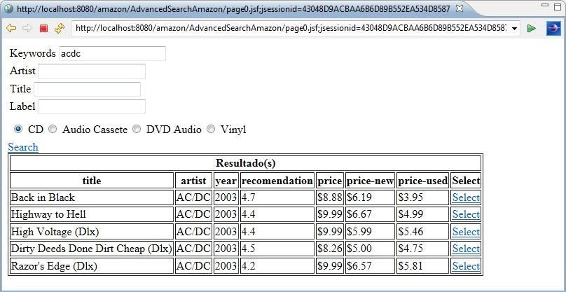
Example
Generated web page corresponding to the second interaction state
1
set of structures (system output)
>> dataTable
2
transition with selection of elements >> commandLink

Slide 26
Example
UID corresponding to the use case.

Slide 27
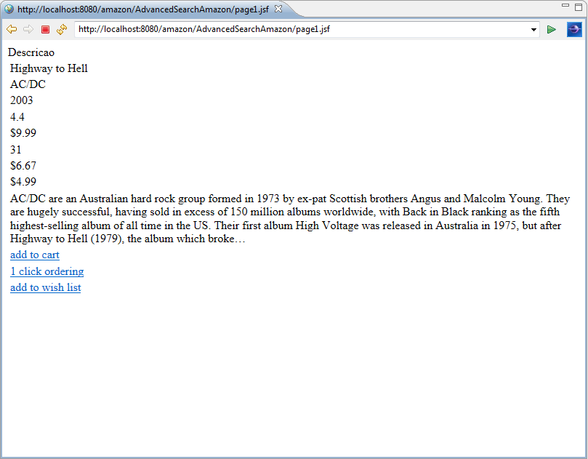
Example
Generated web page corresponding to the third interaction state
1
structure (system output)
>> outputText
transition with option >> commandLink
2

Slide 28
Overview
1. Introduction
2. User Interaction Diagrams
3. Java Server Faces
4. Mapping Rules
5. Example
6. Conclusions

Slide 29
6. Conclusions
We defined a set of mapping rules for generating JSF pages from UIDs.
We developed a prototypical tool that automates the generation of JSF pages by applying those rules.
The generated JSF pages help:
Users validate the requirements;
As an initial prototype for the user interfaces.
Other works also generate user interfaces using model driven transformations, such as UWE4JSF and OO-Method.

Slide 30
Questions?
Filipe Bianchi Damiani
fbd.sk8@gmail.com
Patrícia Vilain
vilain@inf.ufsc.br

