Slide 1
Automatic Analysis of Security Protocols using SPASS
by Christoph Weidenbach

Slide 2
An Automated Theorem Prover for First-Order Logic with Equality
Automatic Analysis of Security Protocols using SPASS

Slide 3
Formalization of a concrete application: Neuman-Stubblebine key exchange protocol.
Proof by refutation:
( Inconsistency ) intruder can break the
protocol.
Proof by consistency:
( Consistency ) no unsafe states exist.

Slide 4
The growing importance of the Internet causes a growing need for security protocols that protect transactions and communication. It turns out that the design of such protocols is highly error-prone.

Slide 5

Therefore, there is a need for tools that automatically detect flaws like, e.g., attacks by an intruder.
A detailed description of the analysis can be found in [2].

Slide 6
Neumann-Stubbleline (1993)
Summary:
Protocol of session key exchange inspired by the Yahalom protocol with the addition of timestamps, and mutual authentication. Symmetric key cryptography with server.

Slide 7
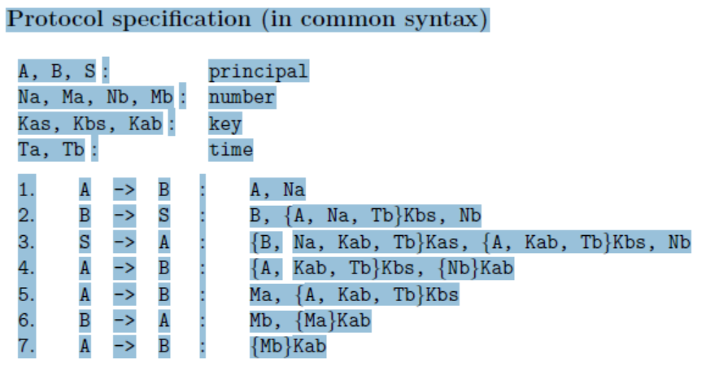

Slide 8
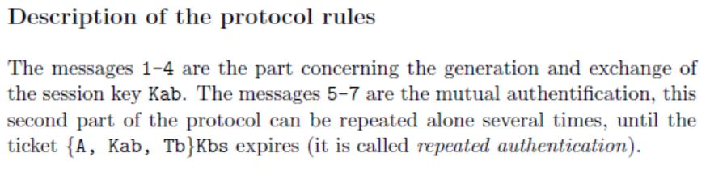

Slide 9
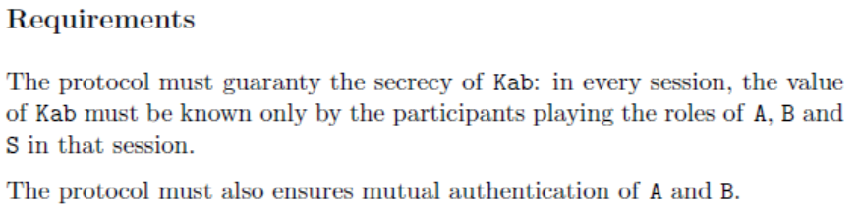

Slide 10

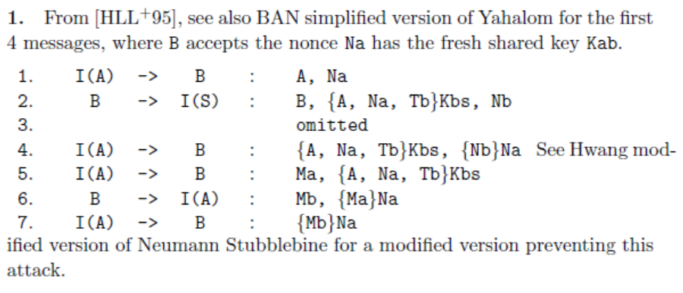

Slide 11
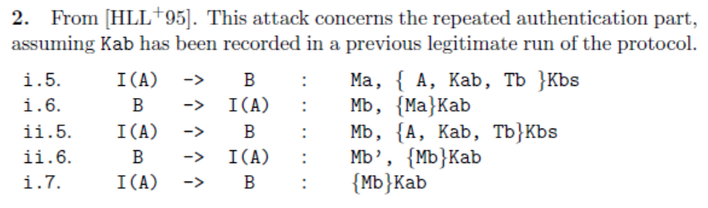

Slide 12
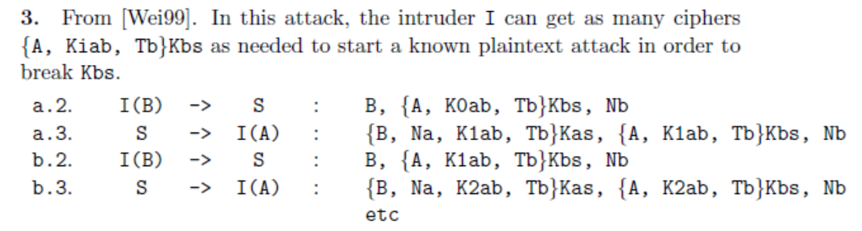

Slide 13
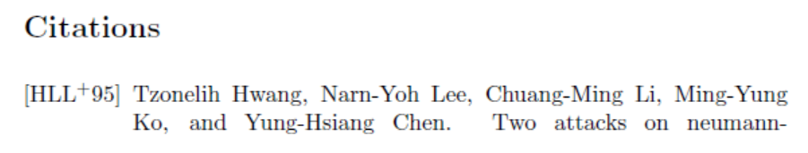
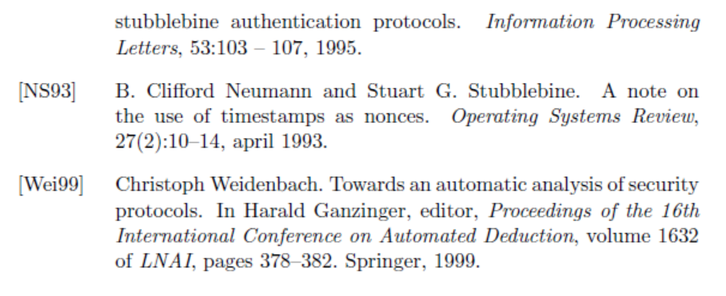
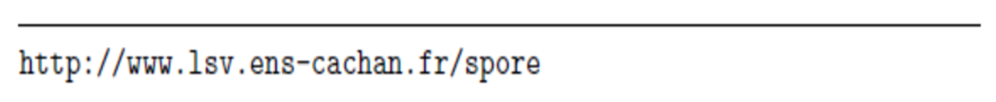

Slide 14
The animation successively shows two runs of the Neuman-Stubblebine [1] key exchange protocol.
The first run works the way the protocol is designed to do, i.e., it establishes a secure key between Alice and Bob.

Slide 15

The second situation shows a potential problem of the protocol.
An intruder may intercept the final message sent from Alice to Bob, replace it with a different message and may eventually own a key that Bob believes to be a secure key with Alice.

Slide 16
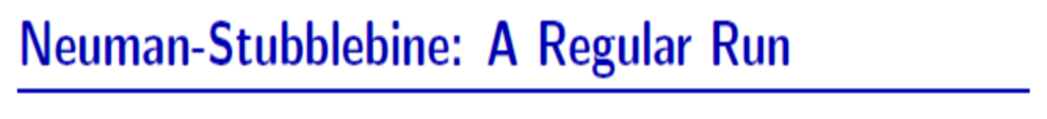
The initial situation for the protocol is that the two participants Alice (A) and Bob (B) want to establish a secure session key, K_{ab}, for communication between them.
They do so with the help of a trusted server trust (Trent) where (master keys, K_{at} and K_{bt}).
The below picture shows a sequence of four message exchanges that eventually establishes the key K_{ab}.

Slide 17
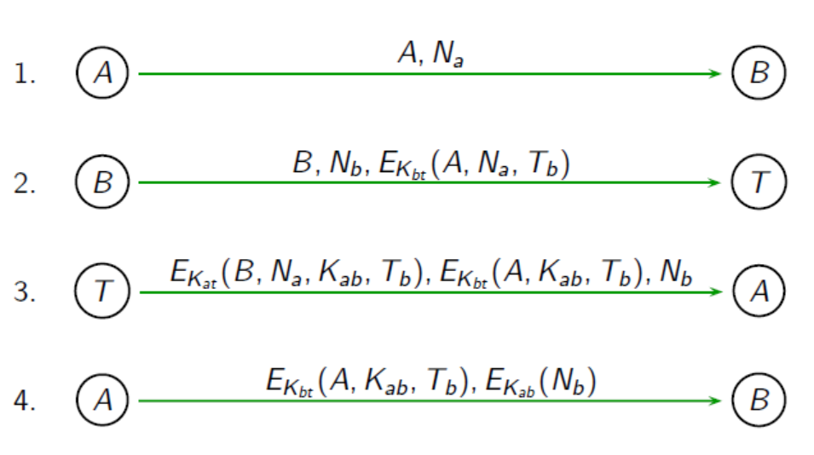

Slide 18
Timestamps
In step 2, T_{b} is a timestamp added to Trent’s message encrypted with the Bob’s key K_{bt}
Timestamps require a secure and accurate system clock - (not a trivial problem itself)

Slide 19
Timestamps
Timestamps works. But it assumes that everyone’s clock are synchronized with a trusted server’s (Trent) clock.
In practice, this effect is obtained by synchronizing clocks with a secure time server.

Slide 20
Timestamp
Whether by system faults or by sabotage, clocks become unsynchronized.
If clocks get out of sync, there is a possible attack against most of these protocols.

Slide 21
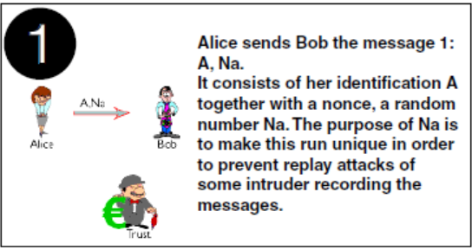

Slide 23
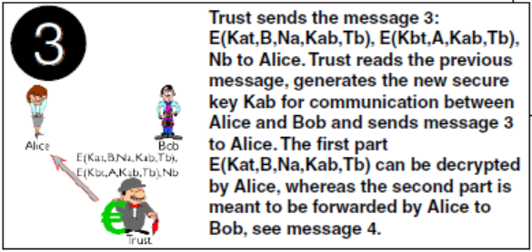

Slide 24
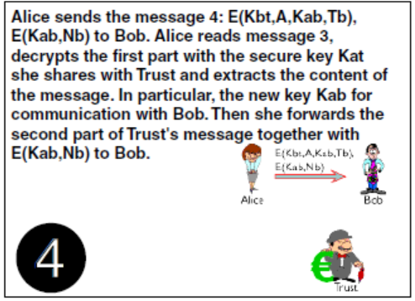

Slide 25
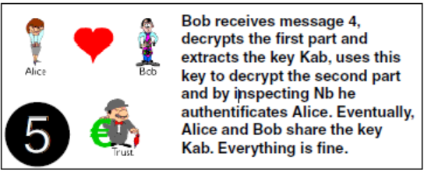

Slide 26
How can an intruder now break this protocol?
The key Kab is only transmitted inside encrypted parts of messages and we assume that an intruder cannot break any keys nor does he know any of the initial keys Kat or Kbt .
Here is what can happen:

Slide 27
The second situation shows a potential problem of the protocol.
An intruder may intercept the final message sent from Alice to Bob, replace it with a different message and may eventually own a key that Bob believes to be a secure key with Alice.

Slide 28
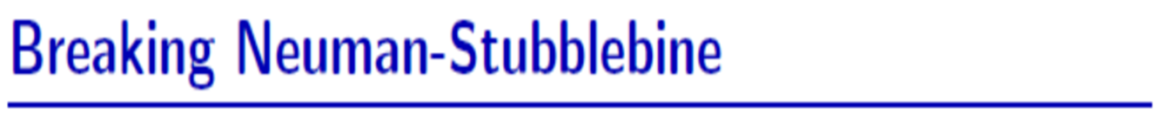

Slide 29
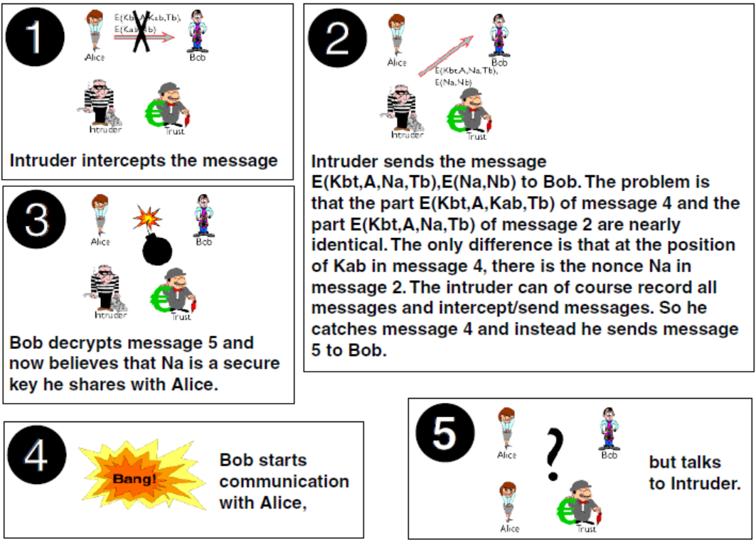

Slide 30
Intruder (I) → Bob (B)
In the final message, Intruder (I) → Bob (B),
Bob decrypts the part of the message E_{bt}(A, K_{ab}, T_{b})
with his key K_{bt} , extracts K_{ab} , and (in a regular
situation Bob confirms that T_{b} and N_{b} have
the same values they did in step 2), …
but now (in a attack of an intruder I) Bob decrypts the
first part of the message E_{bt}(A, N_{a}, T_{b}) , with his key K_{bt}
and believes that N_{a} found is a secure session Key K_{ab} he
shares with Alice.
Bob start communication with Alice … but he talks with Intruder I.

Slide 31
Here we will show that our automated theorem prover SPASS can successfully be used to analyze the Neuman-Stubblebine key exchange protocol [1].

Slide 32

To this end the protocol is formalized in logic and then the security properties are automatically analyzed by SPASS.

Slide 33

The key idea of the formalization is to describe the set of sent messages. This is done by introducing a monadic predicate M in first-order logic.
Furthermore, every participant holds its set of known keys, represented by the predicates Ak for Alice’s keys, Bk for Bob’s keys, Tk for Trust’s keys and Ik for the keys the intruder knows.
The rest of the used symbols is introduced and explained with the first appearance in a formula.

Slide 34
Step 1
The two formulae express that initially Alice holds the key at for communication with t (for Trust) and that she sends the first message.
In order to formalize messages we employ a three place function sent where the first argument is the sender, the second the receiver and the third the content of the message.
So the constant a represents Alice, b represents Bob, t Trust and i Intruder. The functions pair (triple, quadr) simply form sequences of messages of the indicated length.

Slide 35
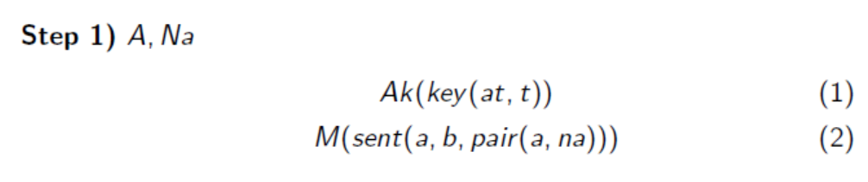
Then the four messages can be translated into the following formulae: Step 1 to Step 4.

Slide 36
Step 2
Bob holds the key bt for secure communication with Trust and whenever he receives a message of the form of message 1 (formula (2)), he sends a key request to Trust according to message 2.
Note that encryption is formalized by the two place function encr where the first argument is the data and the second argument the key.
Every lowercase symbol starting with an x denotes a variable. The functions nb and tb generate, respectively, a new nonce and timestamp of B, tb(xna). span out of xa’s (Alice’s) request represented by her nonce xna.

Slide 37
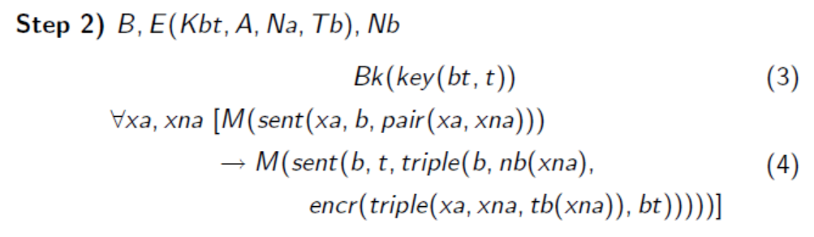

Slide 38
Step 3
Trust holds the keys for Alice and Bob and answers appropriately to a message in the format of message 2.
Note that decryption is formalized by unification with an appropriate term structure where it is checked that the necessary keys are known to Trust.
The server generates the key by applying his key generation function kt to the nonce xna.

Slide 39
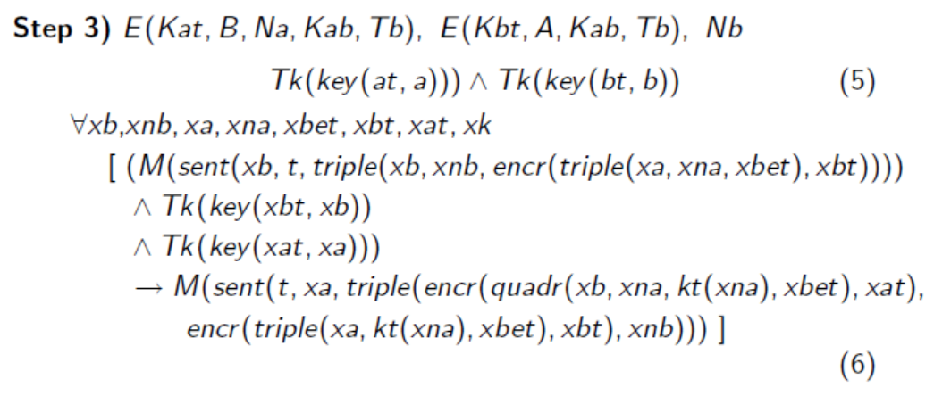

Slide 40
Step 4
Finally, Alice answers according to the protocol to message 3 and stores the generated key for communication, formula (7).
Formula (8) describes Bob’s behaviour when he receives Alice’s message. Bob decodes this message and stores the new key as well.

Slide 41
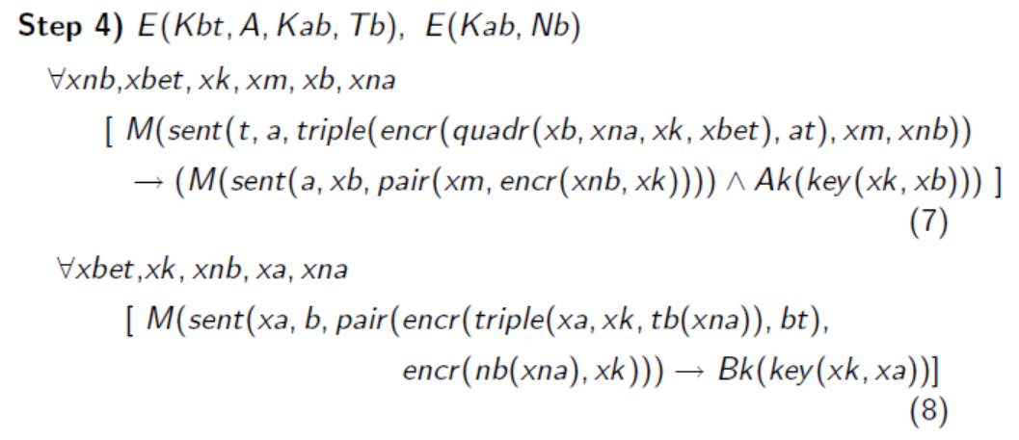

Slide 42
Using the SPASS Sintax
Conjectures = suposições ou hipóteses a serem provadas.
list_of_formulae(conjectures).
formula(exists([x],and(Ak(key(x,b)),Bk(key(x,a))))).
end_of_list.

Slide 43
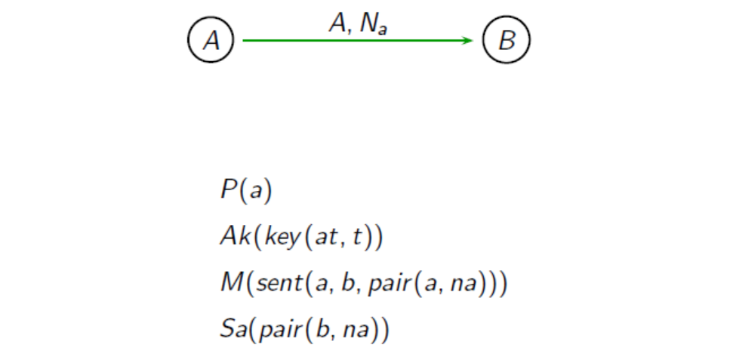
Sa is Alice’s local store that will eventually be used to verify the
nonce when it is sent back to her in Step (3).

Slide 44
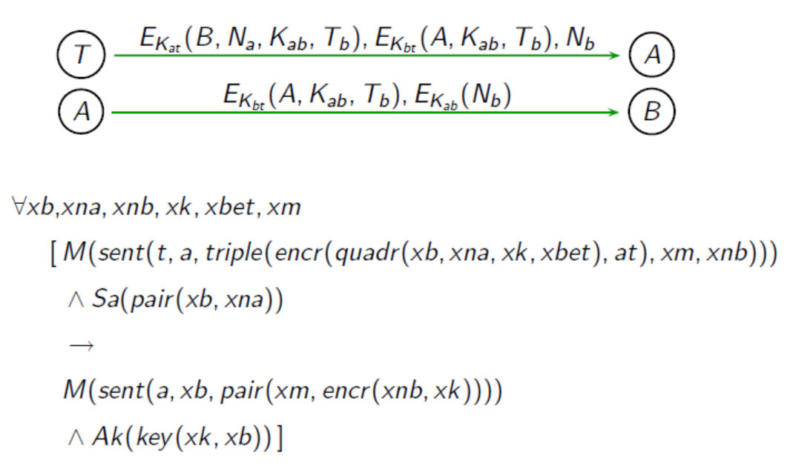

Slide 45
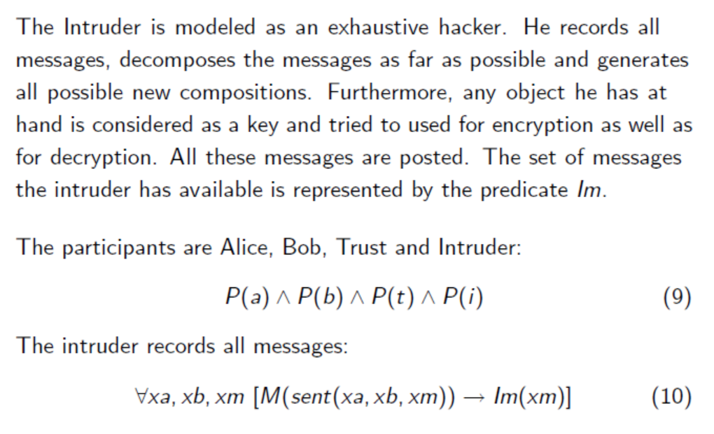

Slide 46
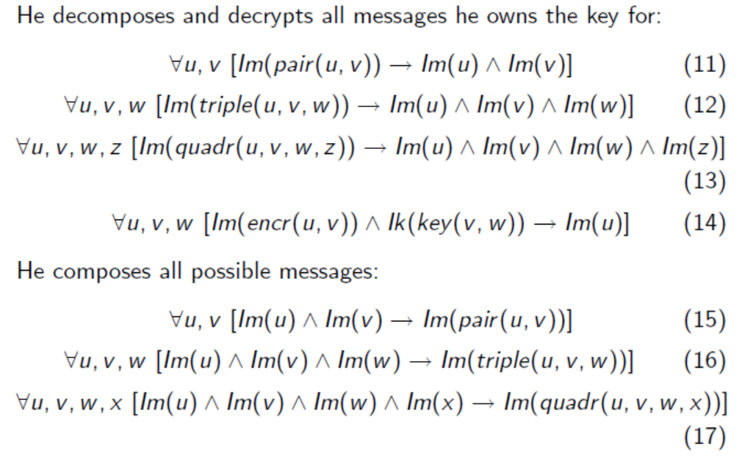

Slide 47
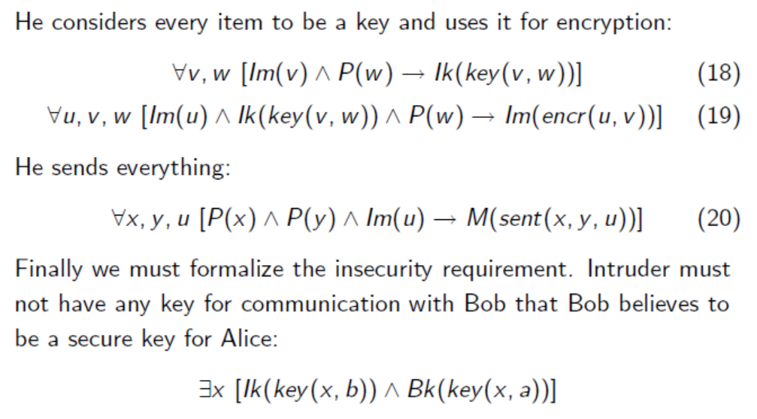

Slide 48
Now the protocol formulae together with the intruder formulae (9)-(20) and the insecurity formula before can be given to SPASS.
Then SPASS automatically proves that this formula holds and that the problematic key is the nonce Na.
The protocol can be repaired by putting type checks on the keys, such that keys can no longer be confused with nonces.

Slide 49
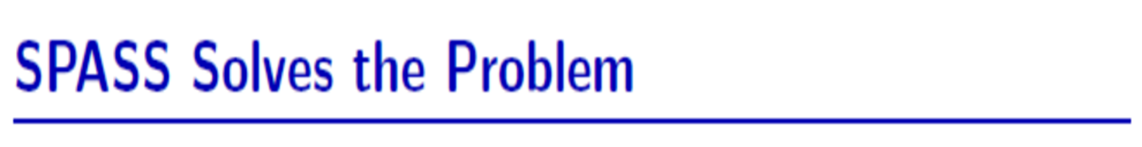
This can be added to the SPASS first-order logic formalization.
Then SPASS disproves the insecurity formula. This capability is currently unique to SPASS.
The experiment is available in full detail from the SPASS home page in the download area.

Slide 50

Based on these References:
[1] Neuman, B. C. and Stubblebine, S. G., 1993, A note on the use of timestamps as nonces, ACM SIGOPS, Operating Systems Review, 27(2), 10-14.
[2] Weidenbach, C., 1999, Towards an automatic analysis of security protocols in first-order logic, in 16th International Conference on Automated Deduction, CADE-16, Vol. 1632 of LNAI, Springer, pp.378-382.

Slide 51
Other Provers
Although some other provers might be able to prove that the insecurity formula holds in the formalization without type checks, we are currently not aware of any prover that can disprove the insecurity formula in the formalization with type checking.
Further details can be found in reference [2].

Slide 52
State-of-the-art in automated theorem proving
NRL Protocol Analyzer (Navy Research Laboratory) - PROLOG
SPASS
ProVerif
Isabelle – High-Order Logic
TAPS: A First-Order Veriﬁer for Cryptographic Protocols
http://www.swmath.org/software/2244
http://www.swmath.org/?term=security%20protocols

Slide 53
A Prática
http://www.spass-prover.org/
Downloads → (Problem Libraries)
The Neuman-Stubblebine Security Protocol Analysis Version 1.1 (.tgz 1KB)
You can copy the above input description for SPASS and paste it in our WebSPASS interface.

