Slide 1
Computação Paralela
Paralell Computing

Slide 2
Parallel Computing
In the simplest sense, parallel computing is the simultaneous use of multiple compute resources to solve a computational problem:
  A problem is broken into discrete parts that can be solved concurrently
  Each part is further broken down to a series of instructions
  Instructions from each part execute simultaneously on different processors
  An overall control/coordination mechanism is employed

Slide 3
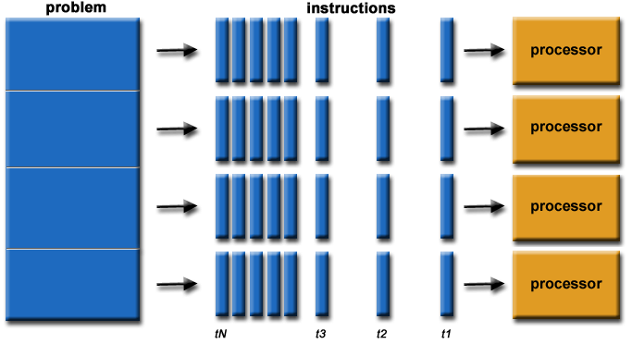
Paralell Computing

Slide 4
The Computational Problem
The computational problem should be able to:
  Be broken apart into discrete pieces of work that can be solved simultaneously;
  Execute multiple program instructions at any moment in time;
  Be solved in less time with multiple compute resources than with a single compute resource.

Slide 5
Compute Resources
The compute resources for paralell computing are typically:
  A single computer with multiple processors/cores.
  An arbitrary number of such computers connected by a network.

Slide 6
OpenMP Programming Model

Slide 7
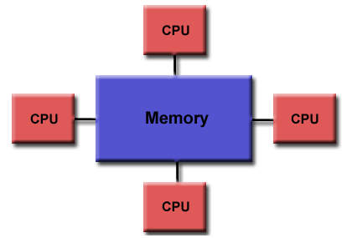
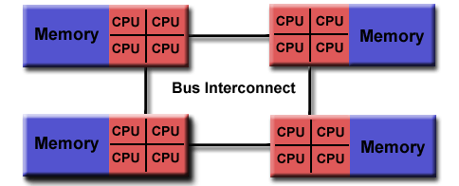
Shared Memory Model
Uniform Memory Access
Non-Uniform Memory Access

Slide 8
OpenMP Shared Memory Model
OpenMP is designed for multi-processor/core, shared memory machines.
The underlying architecture can be shared memory UMA or NUMA.

Slide 9
OpenMP Thread Based Parallelism
OpenMP programs accomplish parallelism exclusively through the use of threads.
A thread of execution is the smallest unit of processing that can be scheduled by an operating system. The idea of a subroutine that can be scheduled to run autonomously might help explain what a thread is.

Slide 10
OpenMP Thread Based Parallelism
Threads exist within the resources of a single process. Without the process, they cease to exist.
Typically, the number of threads match the number of machine processors/cores. However, the actual use of threads is up to the application.

Slide 11
Open MP Explicit Parallelism
OpenMP is an explicit (not automatic) programming model, offering the programmer full control over parallelization.
Parallelization can be as simple as taking a serial program and inserting compiler directives ...
Or as complex as inserting subroutines to set multiple levels of parallelism, locks and even nested locks.

Slide 12
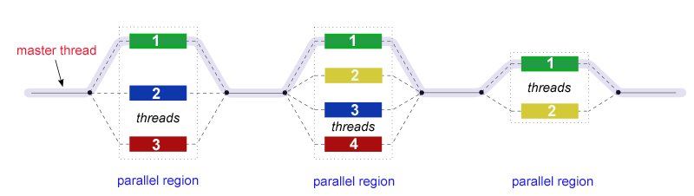
OpenMP Fork - Join Model
OpenMP uses the fork-join model of parallel execution:

Slide 13
Open MP Fork - Join Model
All OpenMP programs begin as a single process: the master thread.
The master thread executes sequentially until the first parallel region construct is encountered.

Slide 14
OpenMP Fork - Join Model
FORK: the master thread then creates a team of parallel threads.
The statements in the program that are enclosed by the parallel region construct are then executed in parallel among the various team threads.

Slide 15
OpenMP Fork - Join Model
JOIN: When the team threads complete the statements in the parallel region construct, they synchronize and terminate, leaving only the master thread.
The number of parallel regions and the threads that comprise them are arbitrary.

Slide 16
OpenMP Compiler Directive Based
Most OpenMP parallelism is specified through the use of compiler directives which are imbedded in C/C++ or Fortran source code.

Slide 17
OpenMP Nested Parallelism
The API provides for the placement of parallel regions inside other parallel regions.
Implementations may or may not support this feature.

Slide 18
OpenMP Dynamic Threads
The API provides for the runtime environment to dynamically alter the number of threads used to execute parallel regions.
Intended to promote more efficient use of resources, if possible.
Implementations may or may not support this feature.

Slide 19
OpenMP I/O = Input/Output
OpenMP specifies nothing about parallel I/O. This is particularly important if multiple threads attempt to write/read from the same file.
If every thread conducts I/O to a different file, the issues are not as significant.
It is entirely up to the programmer to ensure that I/O is conducted correctly within the context of a multi-threaded program.

Slide 20
OpenMP API Overview

Slide 21
Three Components (1)
As of version 4.0:Compiler
The OpenMP API is comprised of three distinct components.
  Compiler Directives (44)
  Runtime Library Routines (35)
  Environment Variables (13)

Slide 22
Three Components (2)
The application developer decides how to employ these components.
In the simplest case, only a few of them are needed.

Slide 23
Three Components (3)
Implementations differ in their support of all API components.
For example, an implementation may state that it supports nested parallelism, but the API makes it clear that may be limited to a single thread - the master thread.
Not exactly what the developer might expect?

Slide 24
Compiler Directives
Compiler directives appear as comments in your source code and are ignored by compilers unless you tell them otherwise - usually by specifying the appropriate compiler flag, as discussed in the Compiling section later.

Slide 25
Compiler Directives
OpenMP compiler directives are used for various purposes: Spawning a parallel region.
Dividing blocks of code among threads.
Distributing loop iterations between threads.
Serializing sections of code.
Synchronization of work among threads.

Slide 26
Compiler directives have the following syntax:
sentinel directive-name [clause, ...]
For C/C++ Example :
#pragma omp parallel default(shared) private(beta,pi)

Slide 27
MPI = Message Passing Interface
Message Passing Interface (MPI) é um padrão para comunicação de dados em computação paralela. Existem várias modalidades de computação paralela, e dependendo do problema que se está tentando resolver, pode ser necessário passar informações entre os vários processadores ou nodos de um cluster, e o MPI oferece uma infraestrutura para essa tarefa.

Slide 28
MPI = Message Passing Interface
No padrão MPI, uma aplicação é constituída por um ou mais processos que se comunicam, acionando-se funções para o envio e recebimento de mensagens entre os processos.

Slide 29
MPI = Message Passing Interface
O objetivo de MPI é prover um amplo padrão para escrever programas com passagem de mensagens de forma prática, portátil, eficiente e flexível.
MPI não é um IEEE ou um padrão ISO, mas chega a ser um padrão industrial para o desenvolvimento de programas com troca de mensagens.

Slide 30
OpenCL
OpenCL (Open Computing Language) é uma arquitetura para escrever programas que funcionam em plataformas heterogêneas, consistindo em CPUs, GPUs e outros processadores. OpenCL inclui uma linguagem (baseada em C 99) para escrever kernels (funções executadas em dispositivos OpenCL), além de APIs que são usadas para definir e depois controlar as plataformas heterogênea.
OpenCL permite programação paralela usando, tanto o paralelismo de tarefas, como de dados.

Slide 31
OpenCL
Ela foi adotada para controladores de placas gráficas pela AMD/ATI, que a tornou na sua única oferta de GPU como Stream SDK, e pela Nvidia.
Nvidia oferece também OpenCL como a escolha para o seu Compute Unified Device Architecture (CUDA) nos seus controladores.
A arquitetura OpenCL partilha uma série de interfaces computacionais, tanto com CUDA, como com a concorrente DirectCompute da Microsoft.

Slide 32
OpenCL
A proposta OpenCL é similar às propostas OpenGL e OpenAL, que são padrões abertos da indústria para gráficos 3D e áudio, respectivamente.
OpenCL estende o poder da GPU além do uso gráfico (GPGPU).
OpenCL é gerido pelo consórcio tecnológico Khronos Group.

Slide 33
CUDA
A Scalable Programming Model
http://docs.nvidia.com/cuda/cuda-c-programming-guide/#axzz4B2DgQ0WL
The advent of multicore CPUs and manycore GPUs means that mainstream processor chips are now parallel systems.
In parallel computing, a barrier is a type of synchronization method. A barrier for a group of threads in the source code means any thread must stop at this point and cannot proceed until all other threads/processes reach this barrier.

Slide 34
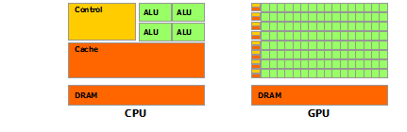
CUDA

Slide 35
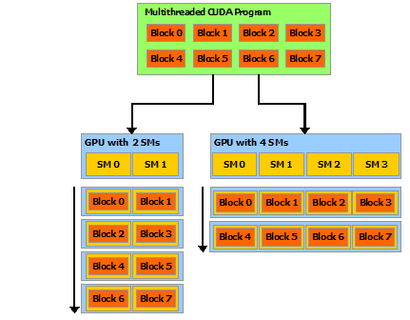
CUDA

Slide 36
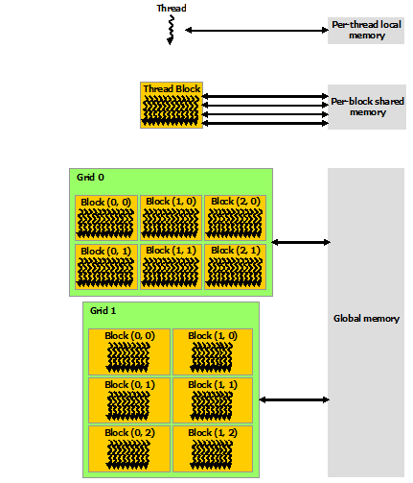
CUDA

Slide 37
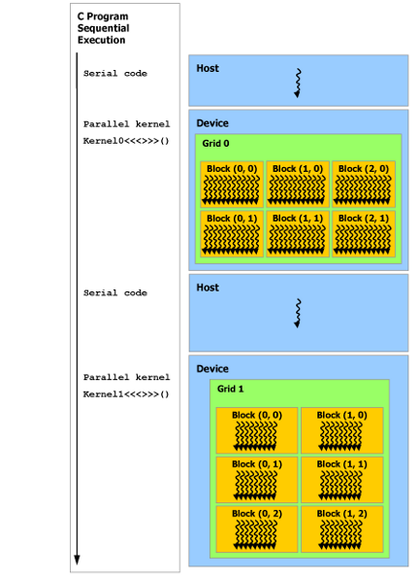
CUDA

